Slide 1


Slide 2
Introduction to Jupyter notebook - Google Colab

Slide 3


What we will acquire after this:
Understanding about what is Jupyter notebook, Google Colab and the reason why we need its.
Using Jupyter notebook, Google Colab for learning path.

Slide 4







What’s Google Colaboratory?
Notes:
Google Colaboratory indicates collaboration and teamwork.
Technically, It’s a Jupyter notebook that is integrated with Google Docs collaboration features.

Slide 5




IT’S A MACHINE LEARNING ENVIROMENT!
Notes:
A machine learning environment in a single notebook which executes your code in the cloud,
and what’s amazing is that since it’s happening remotely on Google Colab’s Server
thus you’re not required to import basic packages or dependencies as they might not be installed on your PC

Slide 6
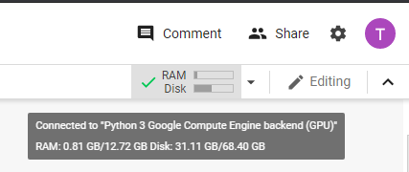
Main Reasons for Using Google Colab.
It encourages teamwork!
Runs code snippets in a click!!
Best Step by Step guide for any deep learning process!!
You don’t have a PC with high-End GPU? Then no Problem! Each colab session is going to equip you with a virtual machine running 13 GB of ram and CPU/GPU/TPU processor.!!!
and approx. 70 GB of disk space.
Execute TensorFlow code in your browser with a single click!!!
Notes:
1 - > which supports the principles of Open Source.
3 -> or you running on a potato.
4 -> haven’t tested yet … sorry.

Slide 7
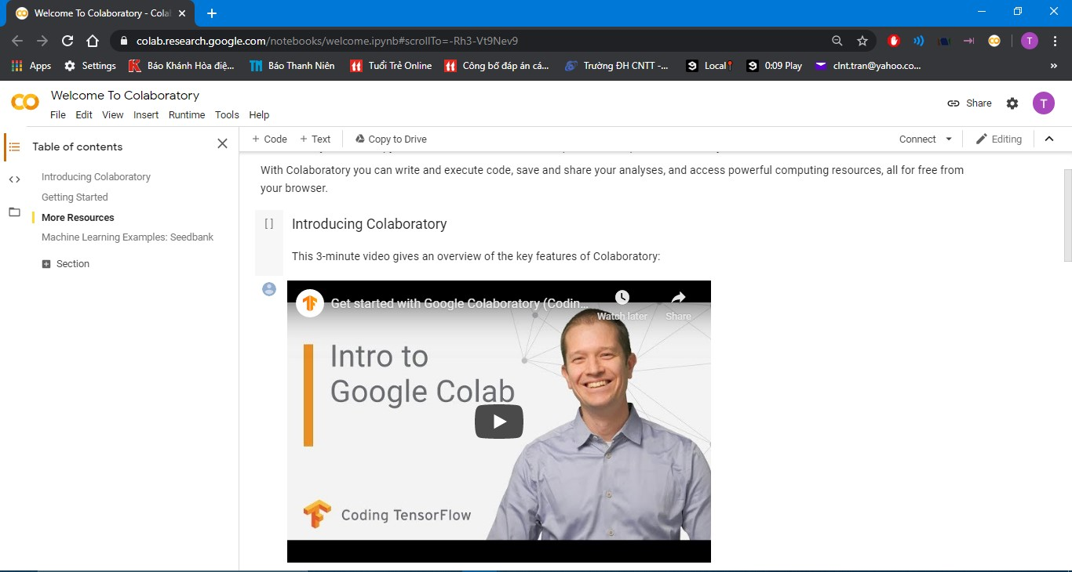
1. LET’S GETTING STARTED!
Visit:https://colab.research.google.com/notebooks/welcome.ipynb#scrollTo=-Rh3-Vt9Nev9
Notes:
Or just type in colab.research … and let google find it for you if you been lazy.

Slide 8



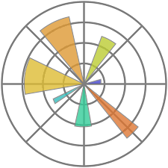

What does Colab. contain?
Basically , it’s a NOTEBOOK – in which you can do:
Write a few lines of texts to describe your codes.
Your codes are onsite executable,but not on your PC, no no , it on their servers.
Some Python modules are pre-installed , so free to import and use them.
Notes:
no ordinary notebook like a notepad file

Slide 9

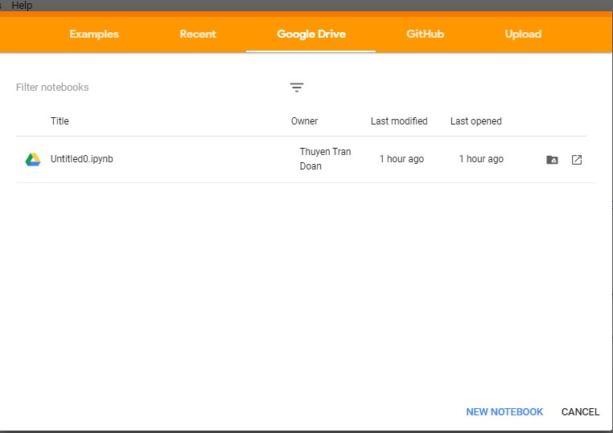
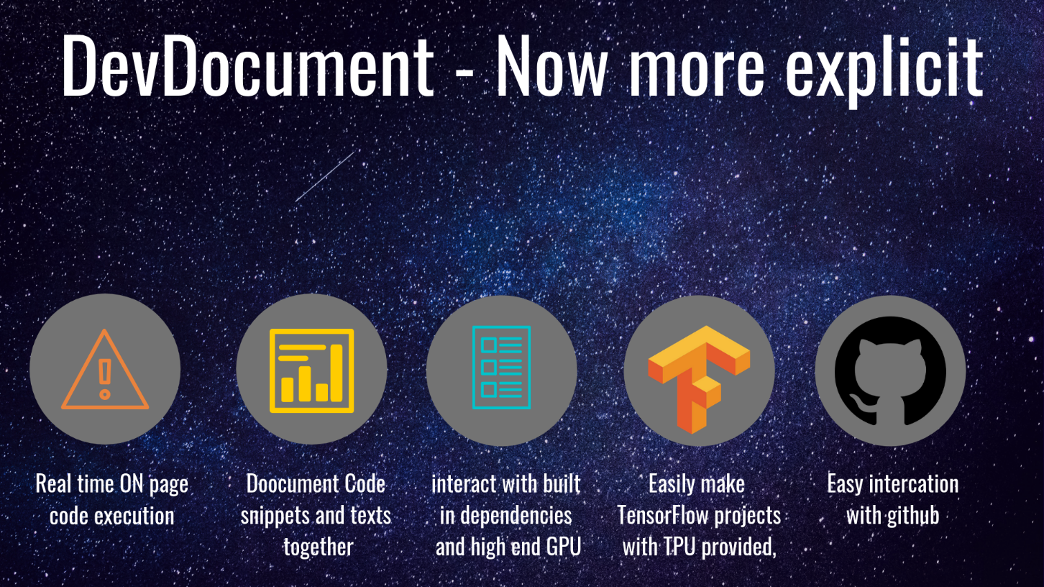
What does Colab. contain? (cont)
Built on top of Jupyter Notebook.
Collaboration feature – meaning works with a team just like Google Docs.
Google Colab notebooks are stored on your drive.
Notes:
- Google Colab allows developers to use and share
Jupyter notebook among each other without having to download, install, or run anything other than a browser.

Slide 10


LET’S DIG IN!!
Create a Colab Notebook
Open Google Drive
Open Google Colab.
Click on ‘New Notebook’ and select Python 2 notebook or Python 3 notebook.
Create a new folder for the project.
Click on ‘New’ > ‘More’ > ‘Colaboratory’.
Notes:
Now , how to reach into colab , there are 2 ways ( to my understanding ), google colab and via google drive.

Slide 11
FEATURES:
Write and execute code in Python.
Document your code that supports mathematical equations.
Create/Upload/Share notebooks.
Runtime configurating.
Import/Save notebooks from/to Google Drive.
Import/Publish notebooks from GitHub.
Import external datasets e.g. from Kaggle.
Integrate PyTorch, TensorFlow, Keras, OpenCV.
Free Cloud service with free GPU.
Notes:
When you already created one, there are a lot of cool features that im going to demonstrate for you today.

Slide 12
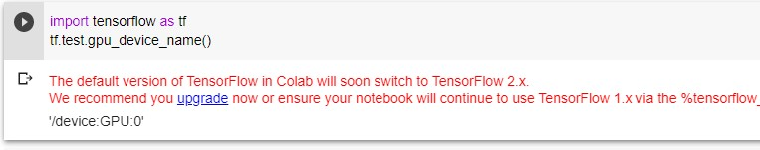
Write and execute code in Python

Slide 13


Document your code that supports mathematical equations

Slide 14
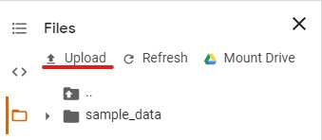
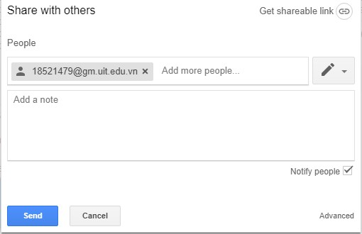
Create/Upload/Share notebooks

Slide 15
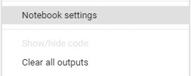

Runtime configurating.
Edit -> Notebook Settings
OR
Runtime -> Change runtime type
More about TPUs : https://www.youtube.com/watch?v=MXxN4fv01c8
Notes:
What is that u gonna get?
In GPU mode u will be provided Tesla 80K – roughly 12Gb of Ram , high processing power.
Or a TPU mode , hardware with principle, architecture mostly

Slide 16
Import/Save notebooks from/to Google Drive

Slide 17


Import/Publish notebooks from GitHub.

Slide 18
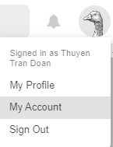
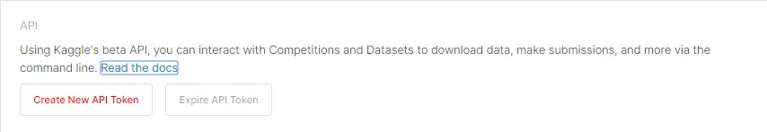
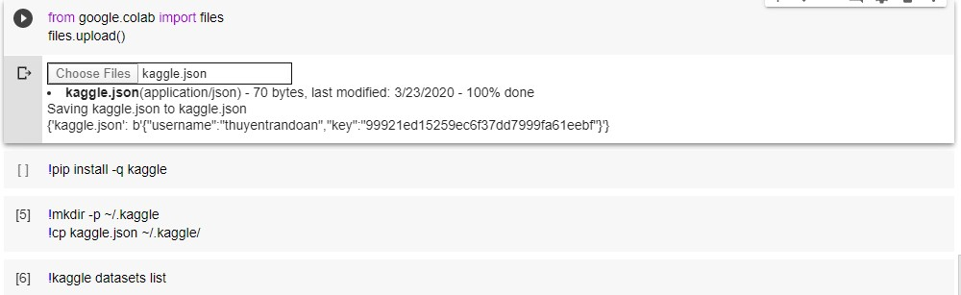
Import external datasets e.g. from Kaggle.

Slide 19
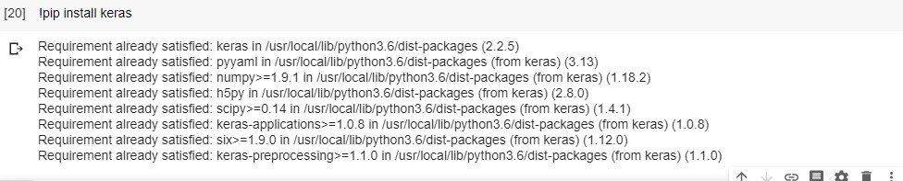
Integrate PyTorch, TensorFlow, Keras, OpenCV (etc)

